Slide 1
British Airways Customer Sentiment Analysis: Driving Business Insights
- Aishwarya

Slide 2
Objective:
To analyze customer reviews of British Airways using sentiment analysis techniques to understand overall passenger perception, identify pain points, and derive actionable business insights for enhancing customer experience.

Slide 3
Project Workflow
Key Steps:
Data Acquisition: Web scraping 1000 passenger reviews from Skytrax using requests and BeautifulSoup.
Data Cleaning & Preprocessing: Lowercased text, removed numbers/punctuation, and filtered out stopwords using nltk.
Sentiment Analysis: Applied two NLP models:
TextBlob: Calculates polarity for each review.
Vader: Provides compound sentiment score tuned for social media and review texts.
Visualisation: Generated sentiment distribution pie charts, bar graphs, and a word cloud to summarise frequent topics.

Slide 4
Tools & Technologies
Tools Used:
Languages & IDE: Python (Jupyter Notebook)
Libraries: requests, BeautifulSoup, pandas, re, nltk, TextBlob, vaderSentiment, matplotlib, WordCloud
NLP Techniques: Stopword removal, polarity scoring, Vader compound scoring
Visualisation: Pie charts, bar charts, and word cloud for insights presentation

Slide 5
Key Findings
Insights:
TextBlob Analysis:
Positive: ~40%
Neutral: ~42%
Negative: ~18%
Vader Analysis:
Similar distribution with slightly different classification thresholds.
Majority of reviews are neutral or positive, but ~18% negative reviews indicate areas for improvement in customer service and operational processes.

Slide 6
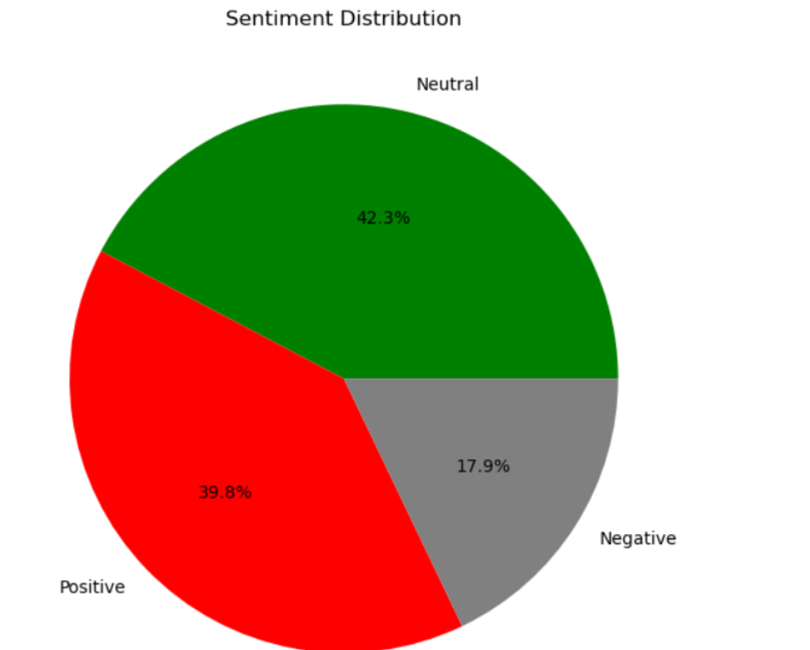
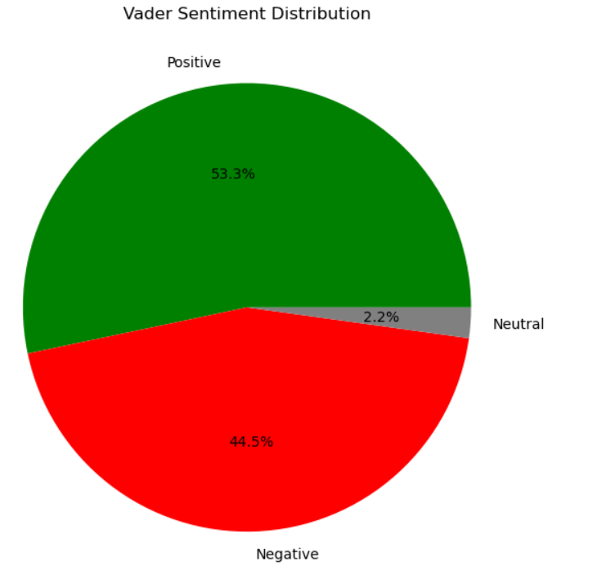
Visualisation
Pie Charts: Sentiment distribution (TextBlob and Vader)

Slide 7
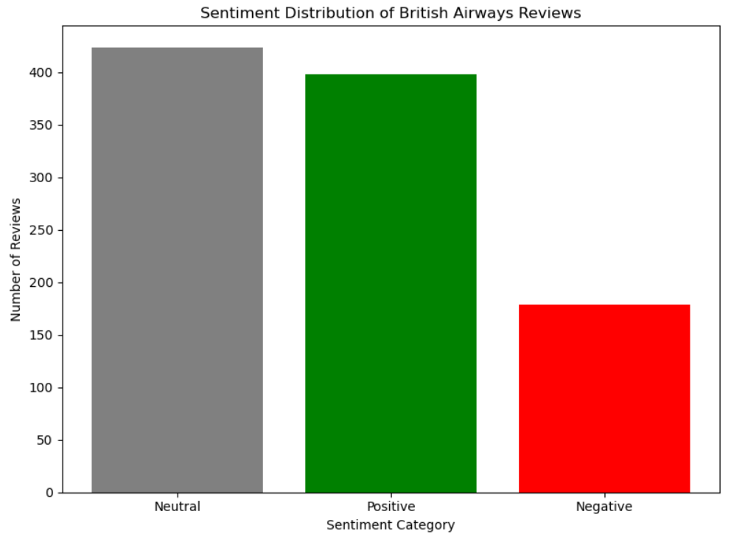
Bar Graph: Count of reviews by sentiment category

Slide 8
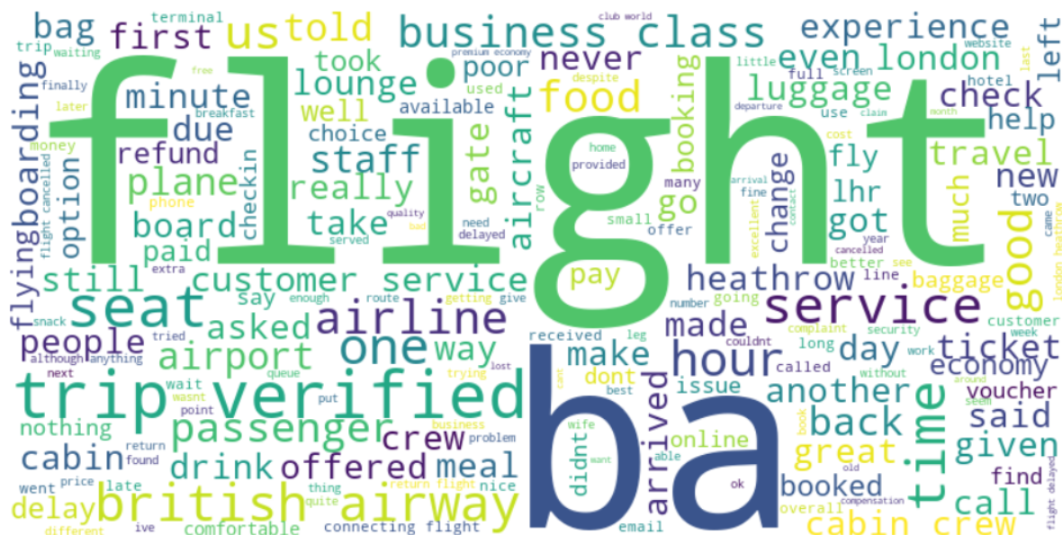
Word Cloud: Frequently mentioned words in reviews (e.g., service, staff, food)

Slide 9
Dataset Summary
Total Reviews Analyzed: 1000
Source: Skytrax (British Airways reviews)
Data Collected: Review texts only
Cleaning Steps: Lowercasing, removing numbers/punctuation, stopword filtering
Prepared dataset ready for sentiment classification and visualization.

Slide 10
Conclusion
The sentiment analysis model effectively uncovers customer perceptions, providing actionable insights to improve British Airways’ services. These findings can enhance customer satisfaction, inform strategic decisions, and strengthen overall brand reputation.

